Slide 1




Implementation of a multithreaded compile-time ECS in C++14
http://vittorioromeo.info
vittorio.romeo@outlook.com
http://github.com/SuperV1234/meetingcpp2016
Notes:
Welcome/presentation.
Mention University/BCS thesis.
About me:
Bloomberg
Dive into C++11/14, vittorioromeo.info
Previous talks (CppCon 2014/2015/2016, Meeting C++, C++Now 2016, ++it Florence 2015)
Previously talked about singlethreaded ECSs at CppCon 2014.
Earlier version of ECST (this talk) discussed at C++Now 2016.
Open-source projects (academical projects, games, libraries).
Mention GitHub and commented code.

Slide 2
Overview of the talk
“Entity-component-system” pattern in general.
Overview of ECST.
Design and core values.
Features/limitations.
Complete usage example.
Architecture of ECST.
Implementation of ECST.
Future ideas.
Notes:
ECST: experimental C++14 multithreaded ECS library that we’re going to analyze.
Why?
Example of template-driven DOD library
Modern hana-based metaprogramming

Slide 3
Entity-component-system
Concepts, benefits and drawbacks of the ECS architectural pattern.

Slide 4
What is an entity?
Something tied to a concept.
Has related data and/or logic.
We deal with many entities.
We may want to track specific instances.
Can be created and destroyed.
Examples:
Game objects: player, bullet, car.
GUI widgets: window, textbox, button.
Notes:
Entity systems allow us to manage entities.
The word entity is frequently used in programming.
Meaning of entity for the scope of this talk.
No real strict definition.
Other examples:
Connected clients in a server application.
Clips in a video-editing application.
AST nodes in a compiler.

Slide 5

Encoding entities – OOP inheritance
An entity type is a polymorphic class.
Data is stored inside the class.
Logic is handled using runtime polymorphism.
Very easy to implement.
Cache-unfriendly.
Runtime overhead.
Lack of flexibility.
Notes:
Implementing entities = «encoding».
Arrow means: «inherits from».
Overhead both in terms of speed and memory.
Vtables.
Virtual calls.
Dynamic allocation.

Slide 6
Encoding entities – OOP inheritance
Notes:
Classic “diamond inheritance” problem.
Lack of flexibility: repetition in inheritance tree branches.
Problem becomes exponentially more annoying by increasing the depth of the tree.

Slide 7
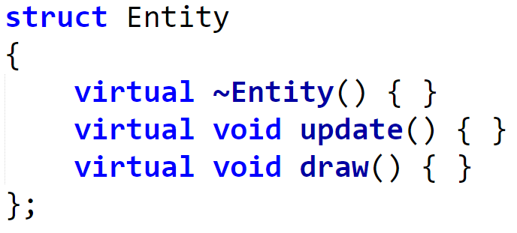
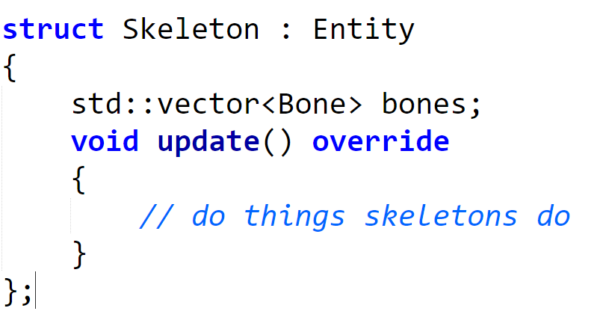
Encoding entities – OOP inheritance

Slide 8

Encoding entities – OOP composition
An entity is an aggregate of components.
Components store data and have logic.
Logic is handled using runtime polymorphism.
Easy to implement.
More flexible.
Cache-unfriendly.
Runtime overhead.
Notes:
Arrow means: «is part of» or «composes».
Components can communicate via references or event buses.

Slide 9



Encoding entities – OOP composition
Notes:
Solves diamond problem and scales well.

Slide 10
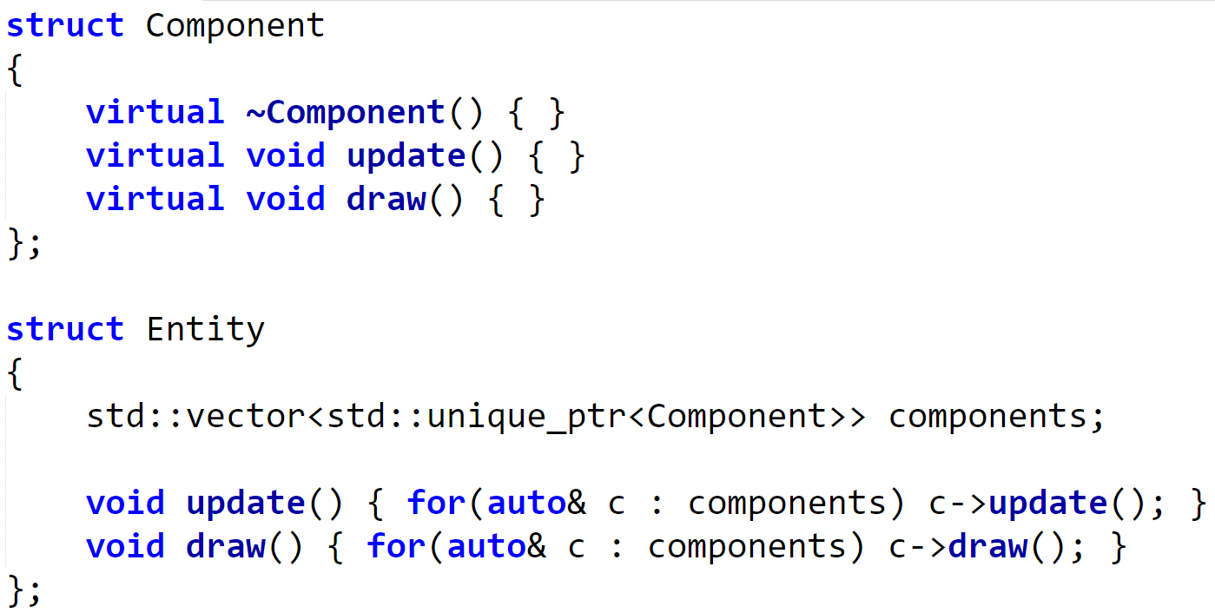
Encoding entities – OOP composition
Notes:
Notice how Entity::update and Entity::draw are not virtual.
Primitive example:
Many optimizations are possible.
Example: map/dictionary with component IDs for faster lookups.
Component communication can be done:
Component bits, retrieve reference.
Event bus.

Slide 11
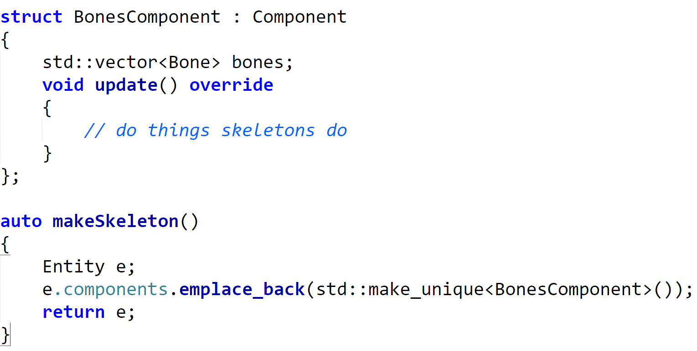
Encoding entities – OOP composition
Notes:
We still do not have the “system” piece of the ECS pattern.

Slide 12
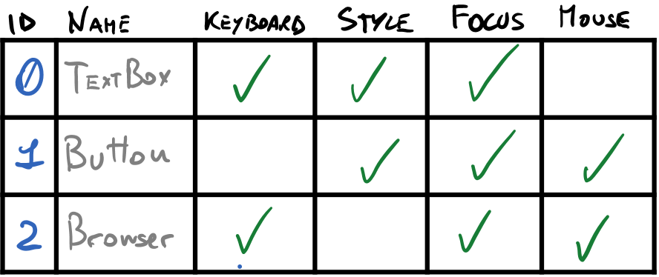
Encoding entities – DOD composition
An entity is a numerical ID.
Components only store data (logicless).
Logic is handled using systems.
Potentially cache-friendly.
Minimal runtime overhead.
Great flexibility.
Hard to implement.
Notes:
DOD: data oriented design.
Take «data oriented» with a grain of salt.
By DO I mean: designed more around data, more cache friendly, avoiding OOP dispatching strategies.
Additional benefits: easy to serialize/network.

Slide 13


Encoding entities – DOD composition
Notes:
The numbers in the rectangles are entity IDs.
Entities «belong» to systems depending on their components.
We usually say that an entity is «subscribed» to a system.

Slide 14
Encoding entities – DOD composition
Notes:
Enemy AI is a system that requires AI and enemy components.
Doesn’t matter if an extra component, like sword, is there.
Every system has a signature (so, a key).
Every entity is a «lock» or «socket».
If the key fits, the entity should subscribe to the system.

Slide 15
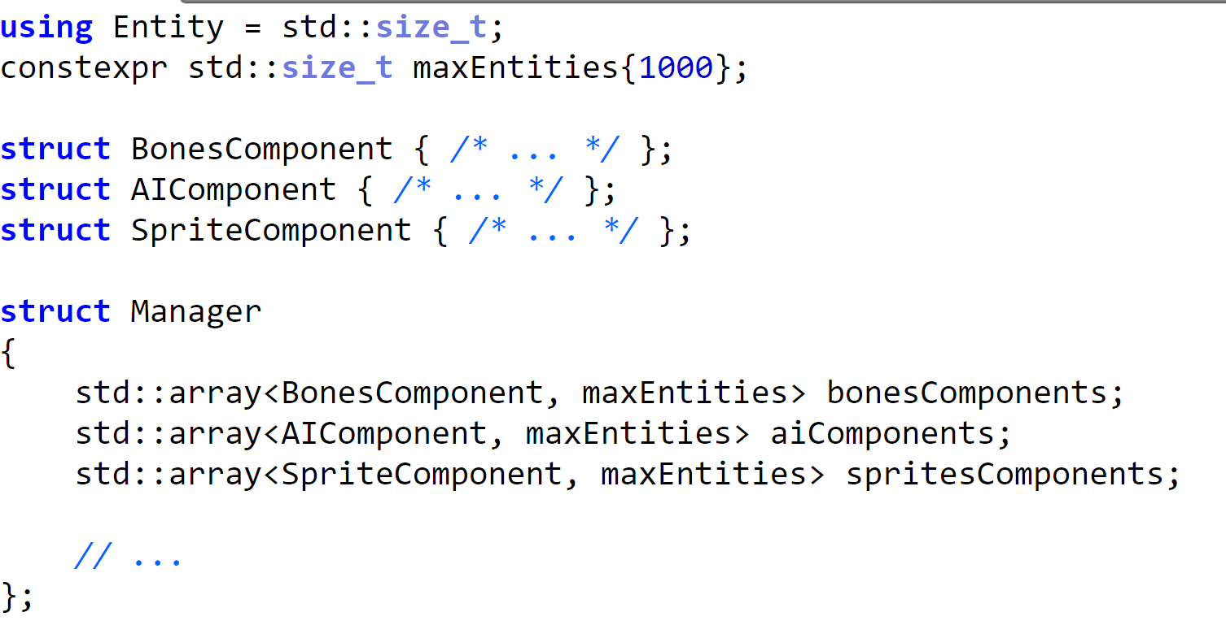
Encoding entities – DOD composition
Notes:
Simple hardcoded example:
We can obviously have different storage strategies and no limit on entities.
Components are usually POD: getter/setters or pure methods can help though.

Slide 16
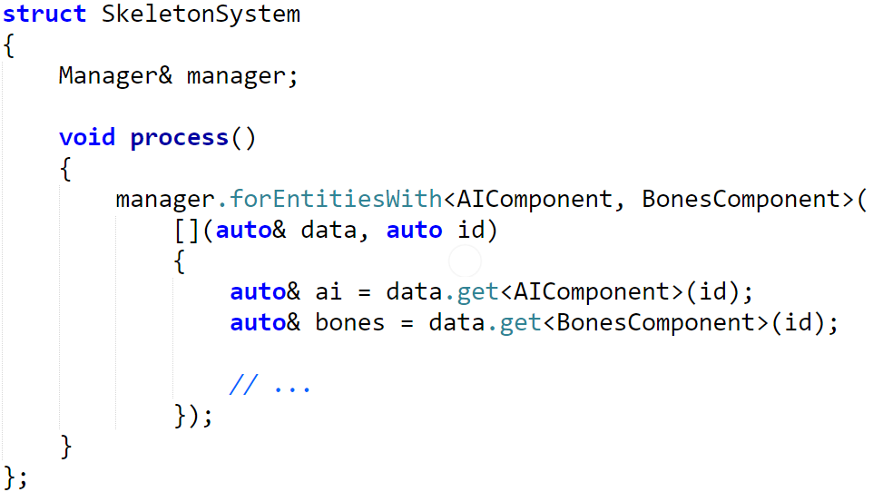
Encoding entities – DOD composition
Notes:
We finally introduce the concept of «system».
The simplest system performs an action or all entities matching its component signature.
Systems can have data and produce outputs.

Slide 17
Storing components - one array per type
Very easy to implement.
Suitable for most projects.
Easy to add/remove components at runtime.
Can be «cache-friendlier».
Wasteful of memory.
Notes:
Storing components efficiently is hard.
Leaves holes: compression can be implemented but it’s «hard».

Slide 18
Storing components – mega-array
Potentially cache-friendlier.
Minimizes memory waste.
Very hard to implement.
Requires indexing tables.
Hard to deal with component addition/removal.
Very hard to keep track of free «slots» in the mega-array.
Notes:
Need an extra structure to keep track of free spaces
Imagine situations where a component is added/removed at runtime
Mention t-machine article, will be linked at end.
ECST: allows the user to choose storage strategies for particular component types.
Component storage strategies may augment entities with their own metadata, thus allowing more complex behavior.

Slide 19
ECST in a nutshell
What is it?
Notes:
Before moving on, ask if notions of entity/component/system are clear to everyone.

Slide 20
ECST in a nutshell – basics
Given some component and system types…
ECST allows users to declaratively define at compile-time:
Component storage layouts.
Used to leverage cache and easily play around with SOA/AOS layout.
Relationships/dependencies between systems.
Used to automatically parallelize system execution.
Parallelism strategies.
System-specific parallelization choices. (e.g. split system S0 in 4 sub-tasks)
Application-wide settings.
(e.g. fixed entity limit VS dynamic entity limit)
Application logic is completely independent from the choices above.

Slide 21
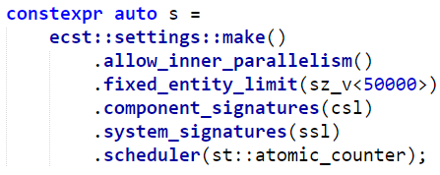
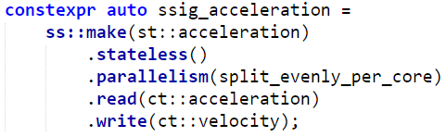
ECST in a nutshell – declarative settings
Compile-time data structure: option maps.
Made easy thanks to boost::hana!
User syntax: fluent method chaining.
Notes:
The implementation of option maps will be covered later.

Slide 22
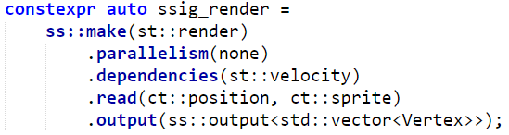
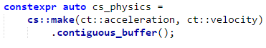
ECST in a nutshell – how to use
Define component types and tags.
Define system types and tags.
Define component signatures.
Define system signatures.
Define context settings.
Instantiate and use ecst::context.
Access system interfaces and component data through proxy objects provided by the context.
Simple C++ classes.
No concepts to satisfy.
No ECST-specific classes to derive from.
Wrappers around types that can be used as values.
Equivalent to: boost::hana::type_c

Slide 23
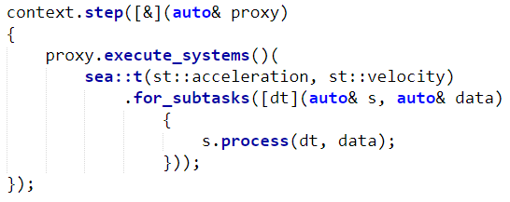
ECST in a nutshell – how to use
Define component types and tags.
Define system types and tags.
Define component signatures.
Define system signatures.
Define context settings.
Instantiate and use ecst::context.
Access system interfaces and component data through proxy objects provided by the context.
Notes:
Proxy objects provide a layer of abstraction between the settings and the application logic.
Proxy objects limit the scope in which particular operations (called critical) can be executed.

Slide 24
Overview of ECST
Design, features, limitations and examples.
Notes:
Before moving on, ask if notions of entity/component/system are clear to everyone.

Slide 25
Core values and concepts
«Compile-time» ECS.
Customizable settings/policy-based design.
User-friendly syntax, independent from settings.
Multithreading support.
Avoid explicit locking.
«Dataflow» programming.
Modern boost::hana metaprogramming.
Clean, modern and safe C++14.
Notes:
We’re going to analyze most of these points in the following slides.
Single-process framework.

Slide 26
«Compile-time» ECS
Component and system types are known at compile-time.
Component instances can be created and destroyed at run-time.
Entities can be created, destroyed and tracked at run-time.
Combining it with run-time solutions is possible.
Minimal run-time overhead.
Better optimization opportunities.
Longer compilation times.
Unwieldy error messages.
Notes:
No explicit virtual calls in ECST.
Less flexibility?
I don’t think so, because you can always add a run-time layer on top of ECST.
Think of a layered ECS architecture with special “bridging” components.
Static and dynamic reflection techniques can also help.

Slide 27
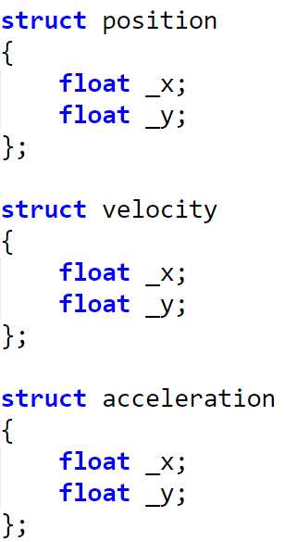
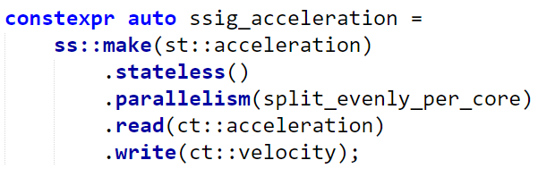
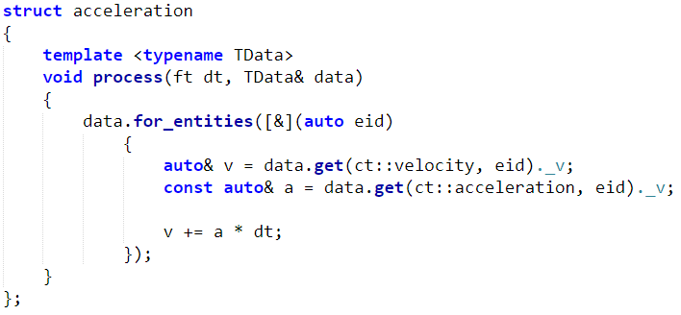
«Compile-time» ECS
Notes:
Full code example soon.
Compile-time knowledge can be used to prevent mistakes.

Slide 28

«Compile-time» ECS – g++ errors
Notes:
g++ 5.3.0.
Filled whole terminal buffer.
Error was a misspelled field in a component.

Slide 29
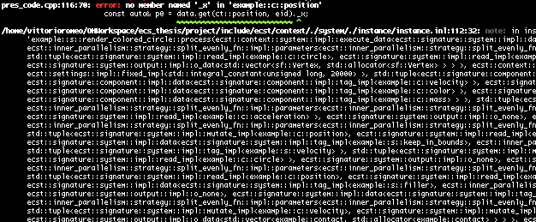
«Compile-time» ECS – clang++ errors
Notes:
Very short compared to g++.
Immediately shows the issue.
Drawbacks: clang compiles almost 2x slower than gcc.
g++ 6 still produces huge errors, but pinpoints the source of the error more clearly.
Fun times: code compiles on clang but not on gcc.
Will try using ideas from the DI talk: type-name erasing and failing early.

Slide 30
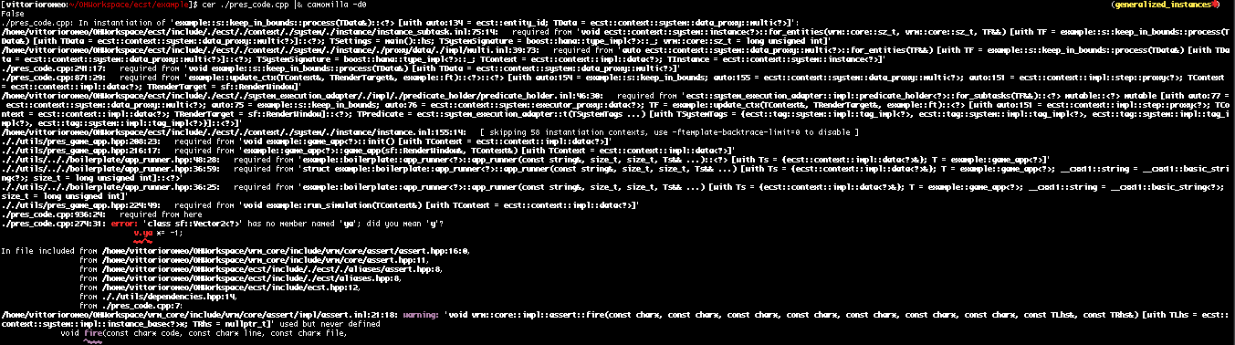
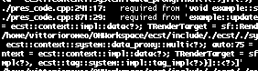
«Compile-time» ECS – camomilla-processed errors
http://github.com/SuperV1234/camomilla

Slide 31
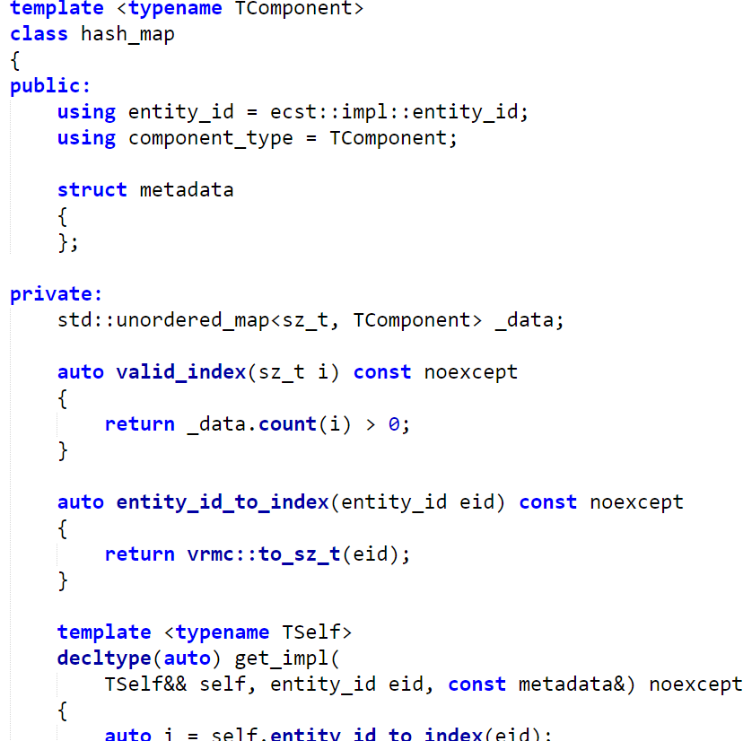
Customizable settings/policy-based design
Behavior and storage layouts can be chosen at compile-time.
Library users can create their own settings easily, including:
Scheduling algorithms.
Parallelization strategies.
Entity and component data structures.
Focus on composability.
Notes:
To add a new entity/component storage, it is sufficient to define a template class satisfying a simple interface.
Parallelism strategies can be composed together, like Alexandrescu’s allocators.

Slide 32
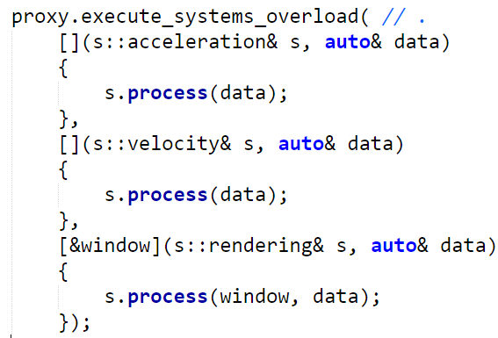
Syntax: independent from settings
Chosen settings and strategies do not affect the syntax of the application logic.
Notes:
Does not matter if the acceleration system is parallelized or not, or if it depends on other systems.

Slide 33
Multithreading support
Enabled by default, customizable and can be optionally disabled.
Two levels of parallelism:
Outer: independent system chains can run in separate parallel tasks.
Inner: system logic can be independently performed on entity subsets in separate tasks.
Notes:
Implicit DAG.
Black circles: systems.
Blue circles: subtasks.
Every system or subtask can produce output.
The successor system can then iterate or fold over the previous outputs.
Dependencies are ensured statically.
Arrows: dependencies.

Slide 34
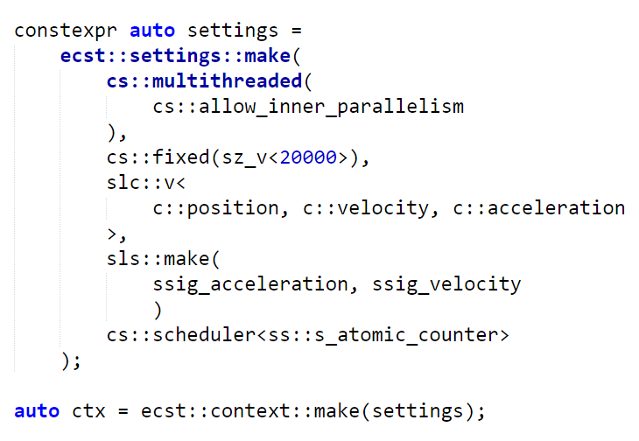
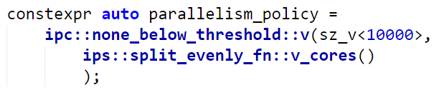
«Type-value encoding»
Every value has a unique type.
Think about std::integral_constant.
Simplifies metaprogramming and compile-time computations.
Notes:
TODO: hana
Also known as dependent-typing.
Origin: Matt Calabrese + Zachary Laine at C++Now (?)
Paul Fultz II, Louis Dionne.
Great article on Paul Fultz’s blog.

Slide 35
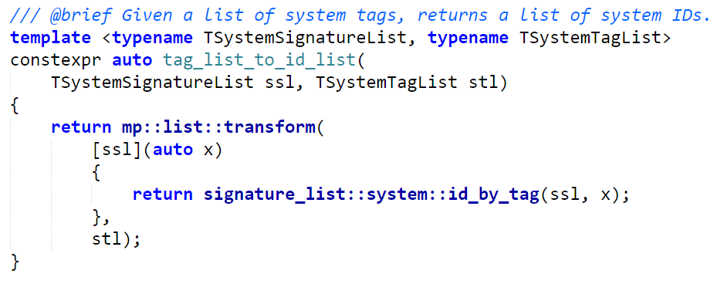
«Type-value encoding»
Notes:
TODO: hana
Type-value encoding is not great only for user code, but also in the implementation.

Slide 36
Code example.
Simple particle simulation implemented using ECST.
Notes:
Show “pres_code” demo and cpp file.
Mention lack of statistics after demo.
Rough estimates:
On my i7 8core machine, 20000 particles have no performance increment with inner parallelism enabled.
200000 particles have around a 2.5x performance increment.
Will create good benchmarks and post them on GitHub in the future.

Slide 37
Architecture of ECST.
“Components” of the entity component system.
Notes:
High-level architecture of the system.
How modules/components are related to each other.
Will make understanding the implementation details easier.

Slide 38
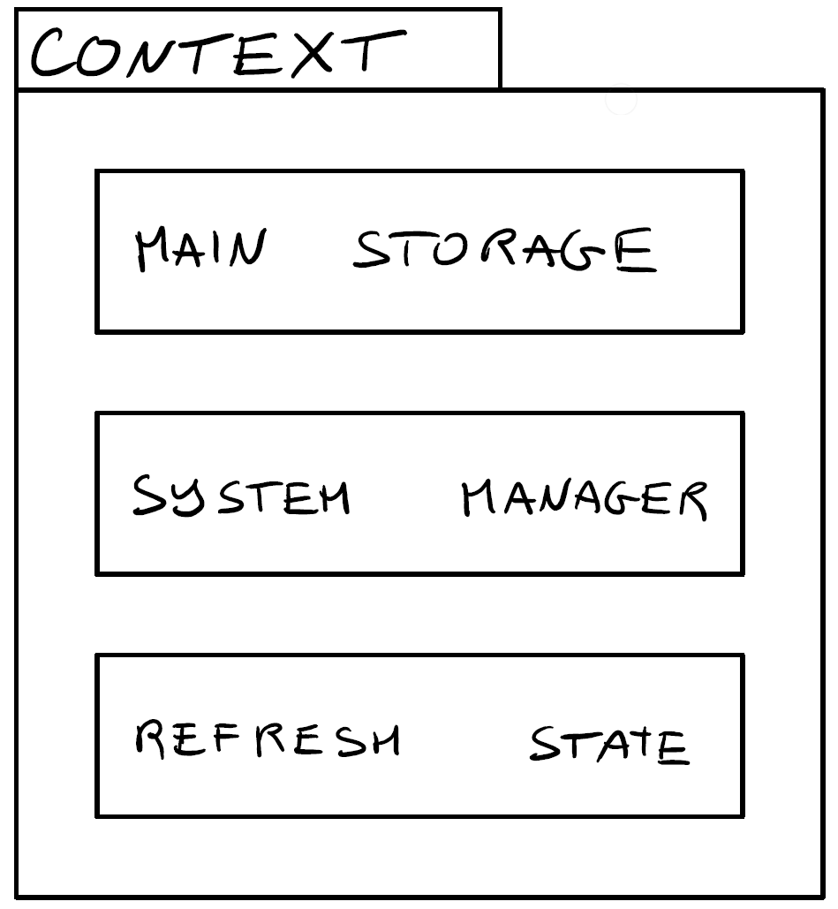
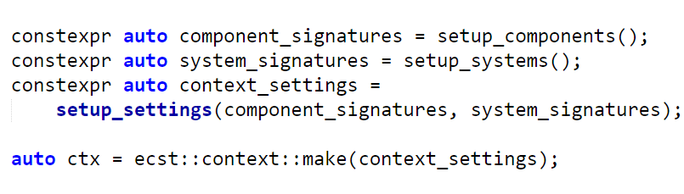
Movable class that aggregates the main components of ECST.
Notes:
Context is a templated class with propagates the settings to its inner classes.
Multiple inheritance is used to expose the inner classes’ public interfaces.

Slide 39
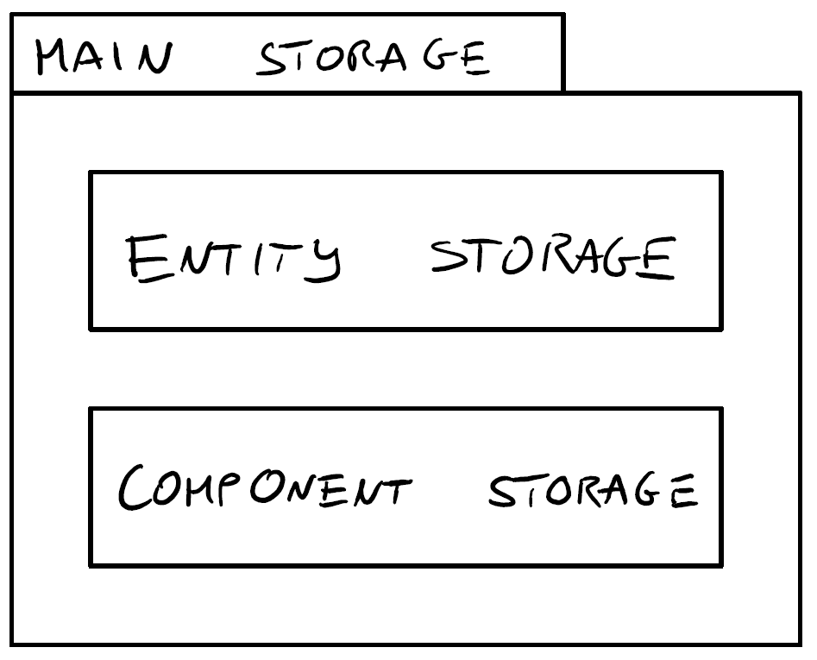
Context -> Main Storage
Encapsulates entity storage, which deals with entity IDs and metadata.
Encapsulates component storage, which deals with component data and component storage strategies.
Notes:
* Entity and component storages interact with each other.

Slide 40
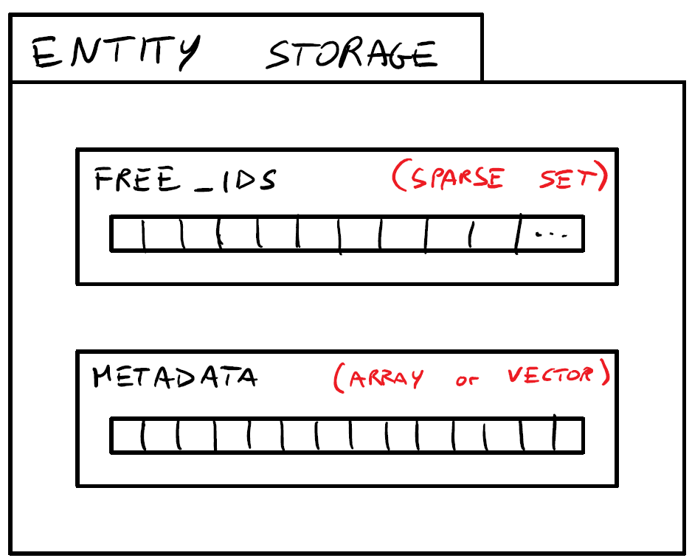
Context -> Main Storage -> Entity Storage
Keeps track of used and unused entity IDs.
Manages entity metadata.
Entity metadata may be enriched by component-container-specific metadata at compile-time.
Notes:
The benefits of sparse sets will be covered in a later slide.
IDs of killed entities can be reclaimed for future use.

Slide 41
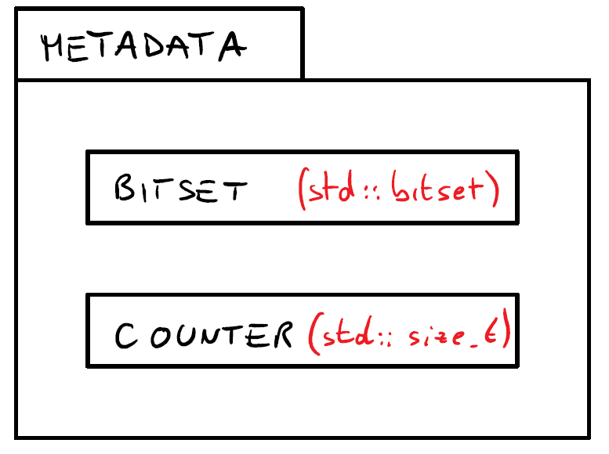
Context -> Main Storage -> Entity Storage -> Metadata
Component bitset: keeps track of current components.
Validity counter: differentiates entity instances which re-use a previous ID. Handles check the counter to prevent access to re-used entities.
Eventual component storage metadata.
Notes:
Component storage metadata is automatically added to entity metadata when a component storage type makes use of it.
Sometimes the ID of the entity is not enough to get the corresponding component, or sometimes additional data can improve performance in particular data structures.
Quick example: component storage that keeps track of history.
Quick example: the mega-array data structure.

Slide 42
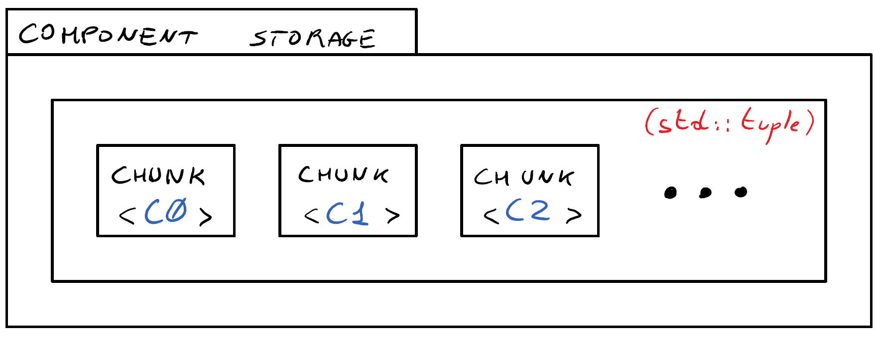
Context -> Main Storage -> Component Storage
Stores a tuple of component storage chunks.
Every chunk stores a specific component type in a specific data structure.
Notes:
Chunks are automatically chosen depending on the component size by default, but can be chosen by the user.
Users can implement their own chunk types.

Slide 43
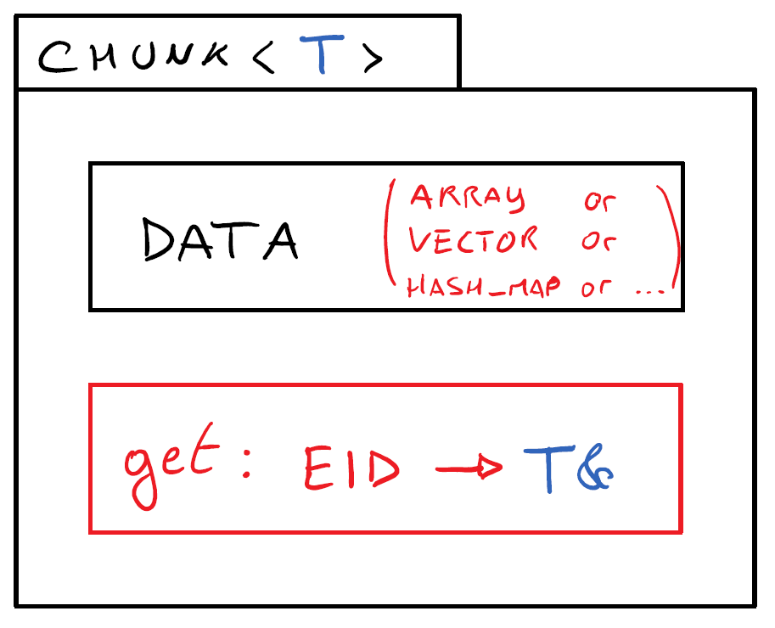
Context -> Main Storage -> Component Storage -> Chunk
Manages component data for a particular component type.
Provides a way to retrieve component data by entity ID.
Notes:
As long as the get and the add methods are provided, any class can be a valid chunk.

Slide 44
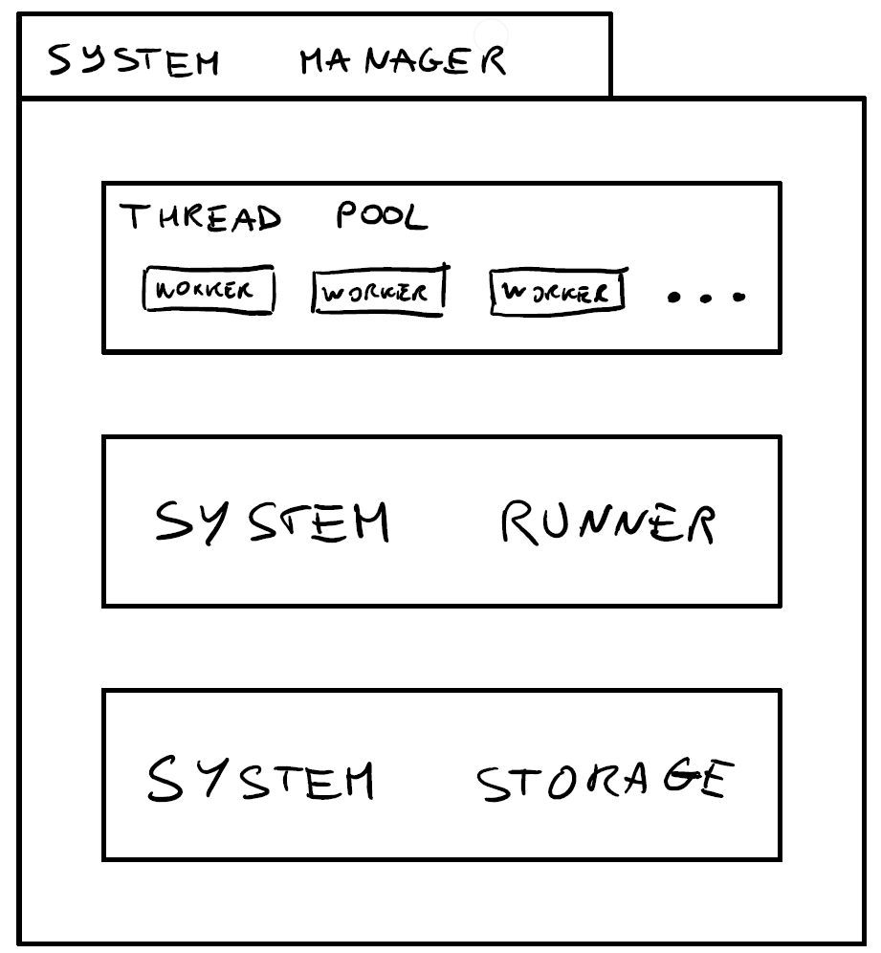
Context -> System Manager
Contains a thread pool, used to execute system logic.
Contains a system runner which provides a nice interface for a system scheduler.
Stores system instances and relative metadata in the system storage.
Notes:
All these elements communicate with each other.
The system runner contains a scheduler that can be chosen at compile time.

Slide 45
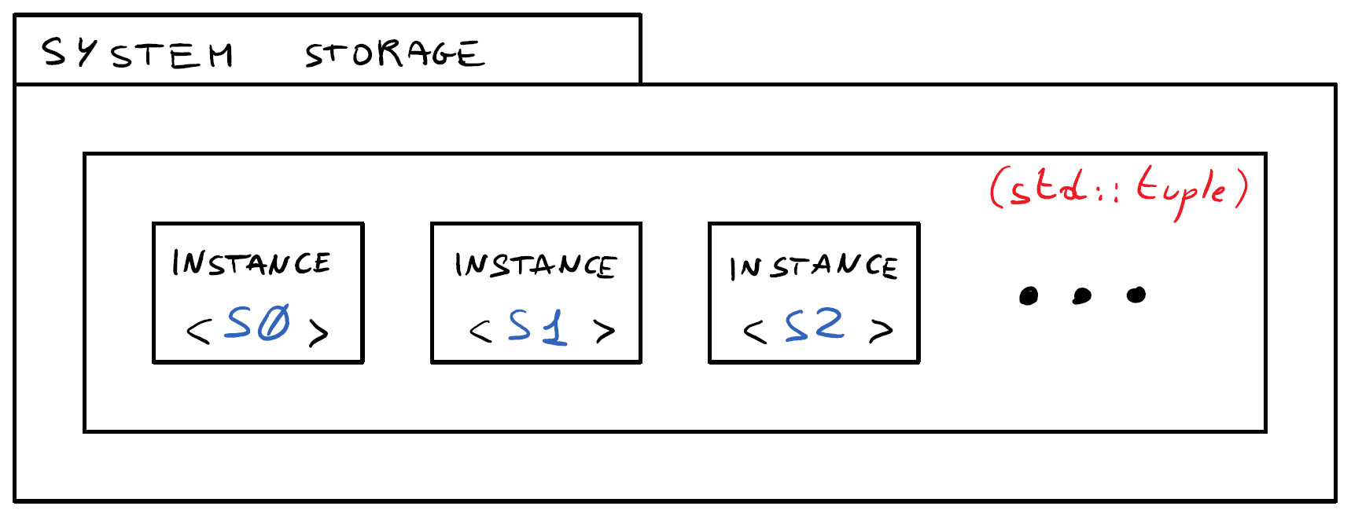
Context -> System Manager -> System Storage
Stores a tuple of system instances, one per system type.
Notes:
Similar to chunks, but instances are not of different types and do not depend on the stored system.

Slide 46
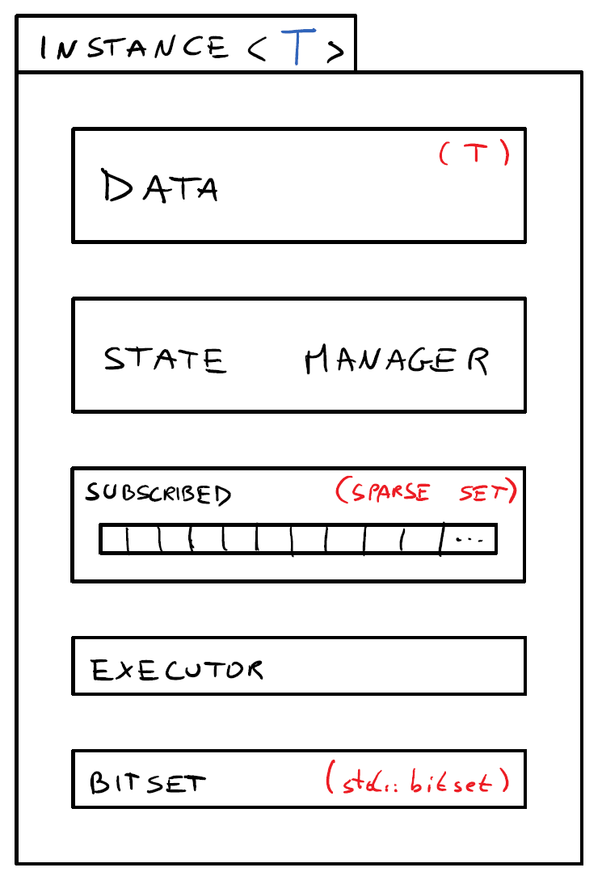
Context -> System Manager -> System Storage -> Instance
Contains an instance of the “real” system type.
Manages N subtasks states through the state manager.
Keeps track of subscribed entities.
Contains a inner parallelism executor instance.
Contains a bitset representing the required components.
Notes:
The bitset is used to match entities to systems.

Slide 47
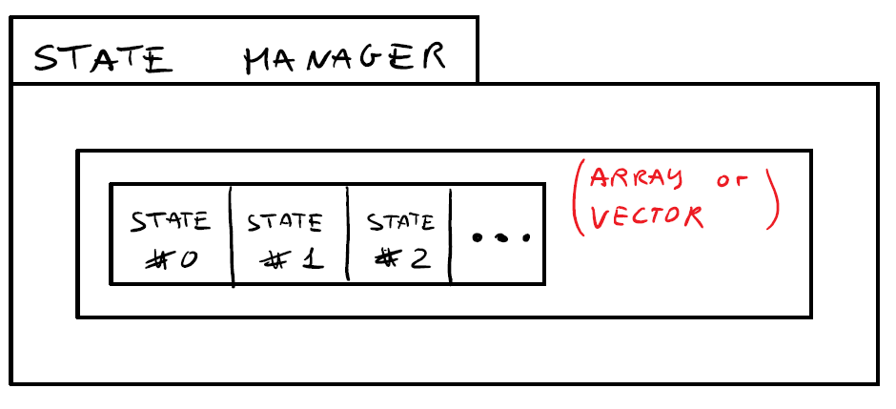
Context -> System Manager -> … -> Instance -> State Manager
Manages a number of states, that can change at run-time.
Every state is connected to a subtask.
Subtasks are executed in separate threads.
Notes:
Let’s say a system is configured to run in 8 separate subtasks by the user.
8 states are created, and 8 subsets of the system subscribers are processed in separate threads.
Every thread has an associated state that can have an output, deferred functions and some IDs to reclaim.
This avoids the “single data structure + lock” bottleneck.

Slide 48
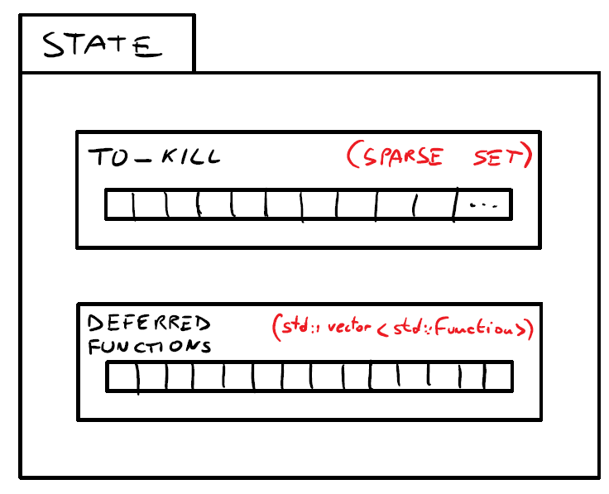
Context -> System Manager -> … -> State Manager -> State
Contains a set of entity IDs that will be killed during the next refresh step.
Contains a vector of deferred functions that will be executed sequentially during the next refresh step.
Optionally contains user-defined system output data.
Notes:
* Output data intuition: list of contacts produced by a collision detection system.

Slide 49
Implementation of ECST.
Challenges, execution flow, multithreading, and metaprogramming.
Notes:
All the code is available on GitHub.
The code is (mostly) commented and can be read on the fly for more details.

Slide 50
Implementation details overview
Execution flow and critical operations.
Implementation challenges.
System processing.
Multithreading details.
System scheduling (outer parallelism).
System inner parallelism.
Proxies.
Metaprogramming module examples.

Slide 51
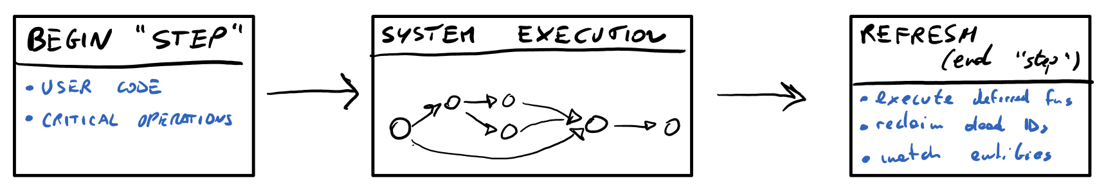
Flow - overview
System execution is preceded by a step, where critical operations can occur.
After system execution, a refresh takes place, during which:
Deferred critical operations are executed.
Dead entity IDs are reclaimed.
New and modified entities are matched to systems.
Notes:
Just an overview – all steps will be covered in depth later.
Think about events that happened during system execution as “pending operations”.
The refresh step will execute those operations.

Slide 52
Flow - critical operations
Operations that need to be executed sequentially in a separate final step are referred to as “critical”.
Critical operations can be queued and deferred to a later step during system logic execution.
Critical operations:
Creating or destroying an entity.
Adding or removing a component to/from an entity.
Running the system scheduler.
Non-critical operations:
Analyzing/using a dependency’s output system data.
Marking an entity as dead.
Accessing and mutating existing component data.
Notes:
Critical operations are “critical” because they may require allocations and/or synchronization.
Deferring critical operations helps avoid processing overhead during system execution.
Try to minimize and batch deferred functions for best performance.

Slide 53
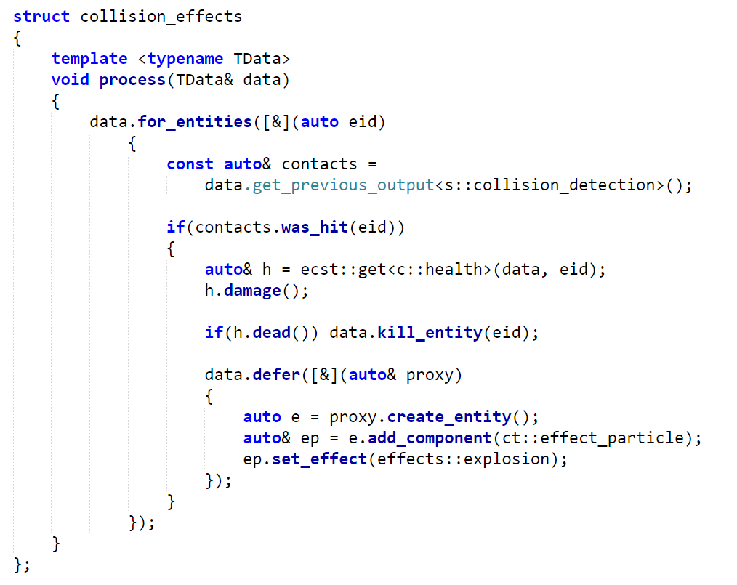
Notes:
TODO: replace old code
Killing an entity is not critical because we’re simply marking the entity as dead.
Every subtask state has a lightweight “dead entity IDs” sparse set.
The subsequent refresh will actually reclaim the entity ID and invalidate handles.
Deferring is implemented using std::function and has significant overhead.
It is preferable to “batch” entity creation as much as possible in defer calls.
I am looking for a better alternative.
Fixed move-only functions?
Customizable “commands”?

Slide 54
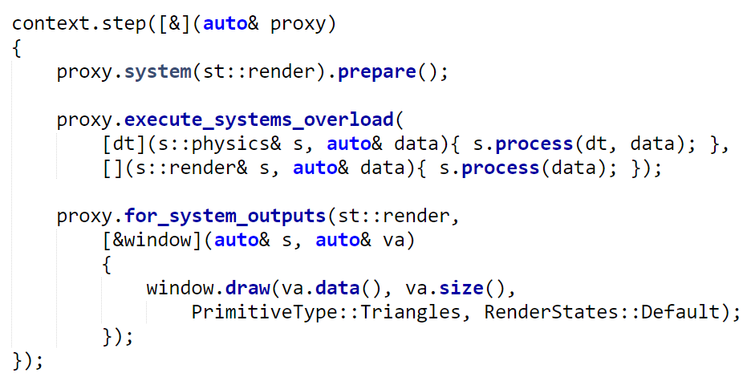
Flow – user code
Notes:
We’ll analyze the flow implementation code later.
We’ll look at some “challenges” first, and their solutions.

Slide 55
Challenges
Efficient management of entity IDs.
Exploiting compile-time knowledge to increase performance and safety.
Executing systems respecting dependencies between them and using parallelism when possible.
Processing entities subsets of the same system in different threads.
Dealing with entity/component addition/removal during system execution.
Providing a clean and safe interface to the user.

Slide 56
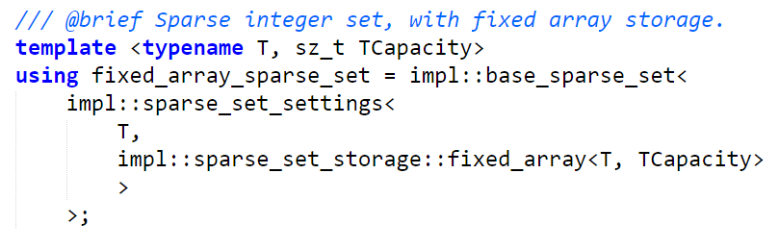
Sparse Integer Sets
Extremely useful data structure to deal with entity ID management.
Conceptually represents a set of unsigned integers.
Allows:
O(1) test, insertion and removal.
O(k) iteration, where k is the number of integers in the set.
Used in system instances (subscribed entities) and in entity storage (available IDs).
Notes:
Pictured: sparse set storage settings.

Slide 57
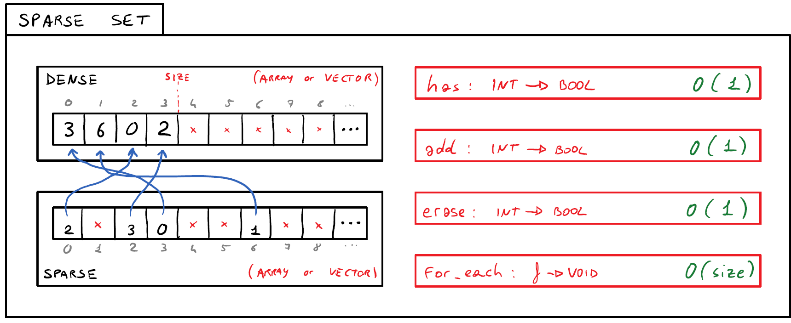
Sparse Integer Sets
Notes:
TODO: mention plf::colony from cppcon 2016 (author name?)
Extremely efficient for entity ID management.
Does not support efficient bitset-like bit operations.
Uses more memory than std::bitset.

Slide 58
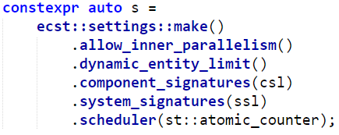
Data structure static dispatching
Users can choose settings at compile-time that can restrict the functionality of ECST in order to achieve superior performance.
Example: max entity limit.
Notes:
TODO: option maps
“Pay for what you use”.

Slide 59
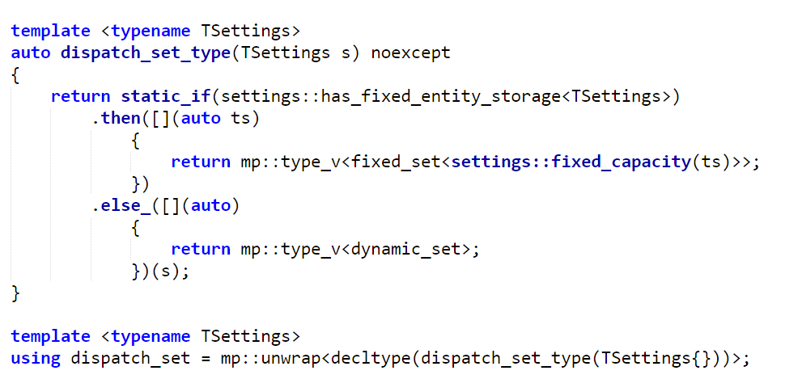
Data structure static dispatching
Notes:
TODO: option maps
Pictured: dispatching sparse set inner storage types.
“static_if” explained in depth in my “Static control flow” talk.
“Type-value encoding” / “dependent typing”.

Slide 60
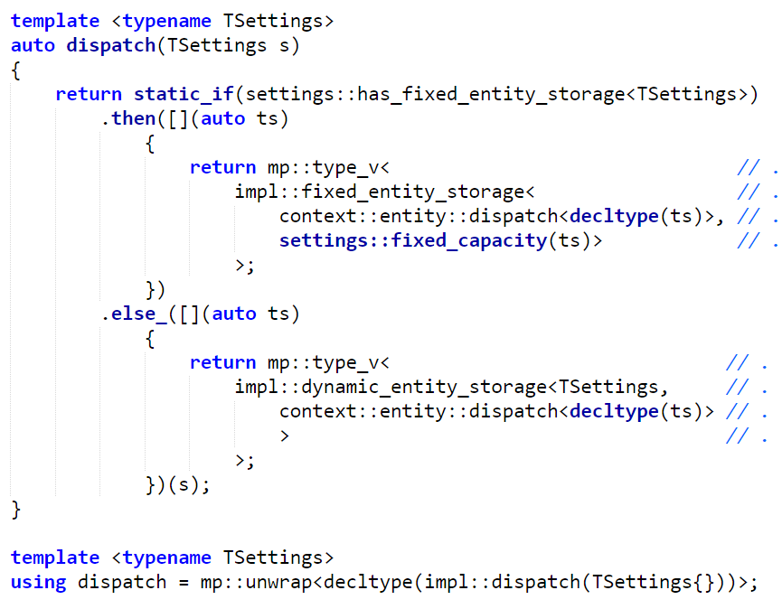
Data structure static dispatching
Notes:
Pictured: dispatching entity storage types.

Slide 61
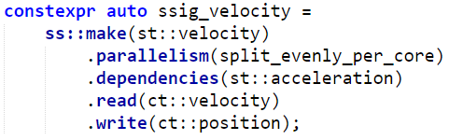
System settings and dependencies
Notes:
Dependencies must be expressed explicitly.
The scheduler will make use of them to run systems in parallel when possible.
Used/read components must be expressed explicitly.
Builds the system matching bitsets.
Allows the compiler to make sure the right components are being accessed, with const-correctness.

Slide 62
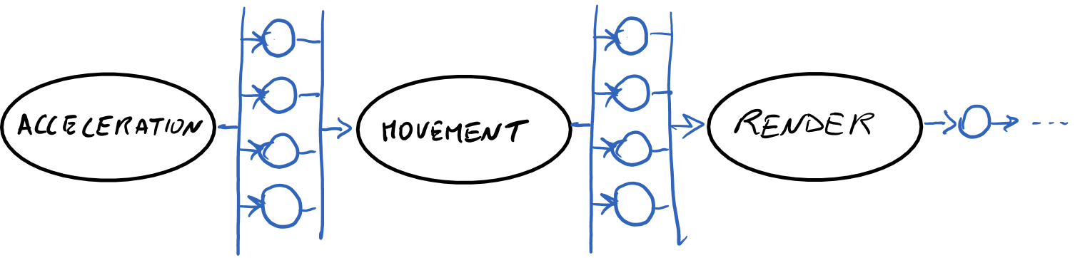
System settings and dependencies
An implicit directed acyclic graph is built thanks to the compile-time system signatures.
Notes:
Code for an explicit DAG is present in the library – could be needed for particular scheduler implementations.

Slide 63
System settings and dependencies
Notes:
Not yet implemented, but planned: additional compile-time checks to make sure the same component is not mutated by multiple systems that can run in parallel.

Slide 64
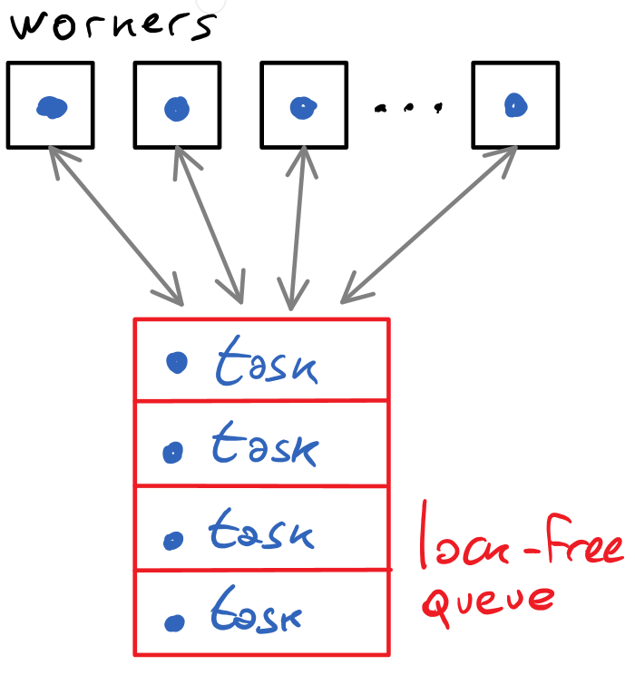
Multithreading details
Avoid busy waiting, use condition variables.
Use thread pooling with a fast lock-free concurrent queue.
Avoid futures, use atomic counters with condition variables to wait for tasks to complete.
Notes:
Futures and packaged_tasks had a significant runtime performance overhead.

Slide 65
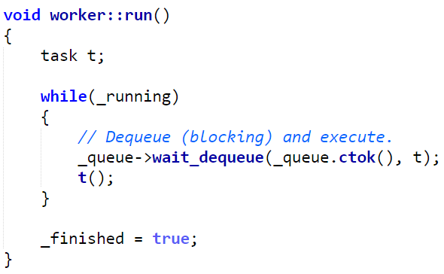
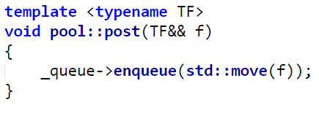
Multithreading details – lock-free queue
moodycamel::BlockingConcurrentQueue
By Cameron Desrochers (cameron314 on GitHub).
https://github.com/cameron314/concurrentqueue (Simplified BSD License)
Notes:
Very fast and lightweight.
User-friendly C++11 interface.
Uses producer/consumer “tokens” to be even faster.
Pictured: parts of thread pool implementation.

Slide 66
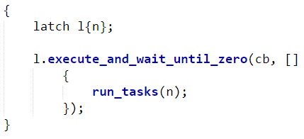
Multithreading details – synchronization
Condition variables and counters are used to wait for multiple tasks to complete.
Used both in system scheduling and in inner parallelism.
The latch struct aggregates a mutex, a condition variable and a counter.
Notes:
TODO: it’s a latch! (mention std latch)
counter_blocker stores the necessary synchronization primitives to wait for n subtasks to finish.
execute_and_wait… immediately executes the function and blocks the current thread until cb’s counter reaches zero.
Assumes that the function will deal with decrementing the counter.
Alternative to busy waiting.

Slide 67
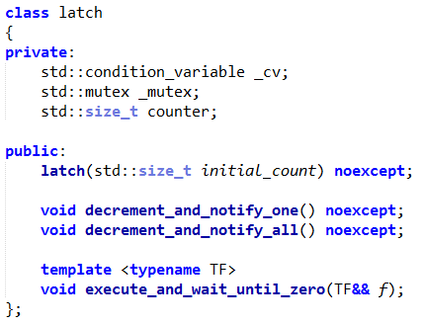
Multithreading details – synchronization
latch is essentially a simple abstraction to prevent busy waiting.
Clean «interface» functions that take it as a parameter are defined for convenience and safety.
Notes:
TODO: it’s a latch! (mention std latch)

Slide 68

Multithreading details – synchronization
Access to the counter is synchronized thanks to a lock_guard that locks the mutex contained in the counter blocker.
The passed function will be executed after locking, to prevent mistakes and explicit locking.
Notes:
TODO: update code, latch

Slide 69

Multithreading details – synchronization
This is how the counter is decremented and the waiting threads are notified.
Notes:
Notice the assertion for additional safety.
TODO: update code, latch

Slide 70

Multithreading details – synchronization
The above function is used to wait for a predicate to become true.
As previously seen, a function is passed to avoid mistakes, explicit locking and explicit waiting.
Notes:
It is assumed that “f” will eventually make the predicate evaluate to true.

Slide 71

Multithreading details – synchronization
The previously shown functions have “interface versions” that take a counter blocker as a parameter.

Slide 72
System scheduling
Current scheduling policy: “atomic counter”.
Explored alternative: when_all(…).then(…) chain generation.
The scheduler uses a remaining systems counter_blocker which keeps track of how many systems have been executed.
The caller thread blocks until all systems’ executions have been completed.
Every system instance uses a remaining dependencies atomic counter.
In the beginning, all instances with zero dependencies are executed.
As soon as an instance is done, all dependents’ counters are decremented.
If a dependency counter reaches zero, that instance is executed.
Notes:
Chain generation: hard to implement and get right. Has future and shared_ptr overhead.

Slide 73

System scheduling - scheduler
Notes:
The scheduler starts the system task DAG execution.
We need to block until all systems have been executed.
TODO: update code, latch

Slide 74

System scheduler – system task execution
Notes:
Every “task” here is a system instance execution task.
Inner parallelism produces “subtasks”.
The passed f function is usually an overloaded lambda set which allows the user to conveniently pass external data to the systems.
TODO: update code, latch

Slide 75
System inner parallelism
Every running system instance can be split in subtasks.
The instance has a counter of running subtasks.
As soon as a subtask is finished, the counter is decremented.
A counter blocker is used to wait for the counter to become zero.
Splitting strategies can be composed at compile-time and extended by the users.
Strategy executors can be stateful.
Motivating example: self-profiling executor that chooses between single-threaded and multi-threaded system execution during application run-time.

Slide 76

System inner parallelism – parallel execution
System inner parallel execution is done through a parallel executor, which is stored inside the system instance and encapsulates an execution strategy (or a composition of strategies).
Synchronization is handled inside the executor.
Notes:
TODO: update code

Slide 77


System inner parallelism – executor example
Notes:
Pictured: split_evenly executor. Splits the system in N even subtasks.
In the example, N=4.
TODO: update code

Slide 78

System inner parallelism - slicing
The above function binds a range of entities (subset of subscribed entities) to an execution callable object.
Notes:
We are creating a callable object that stores the range begin/end indices.
The callable object will execute the processing function on those indices, and decrement the remaining subtask counter upon completion.
TODO: update code

Slide 79


System inner parallelism - slicing
The above function creates a data proxy and runs the parallel subtask function passing it as one of the parameters.
Notes:
TODO: update code

Slide 80
Proxies
Proxies are used to limit the scope in which critical operations can be executed.
Data proxies are used during system execution to provide component data access and system output access.
Defer proxies are used in defer(…) calls to allow the user to queue up critical operations that will be executed in the refresh step. Step proxies derive from defer proxies, and allow the execution of system schedulers.

Slide 81

Proxies – data proxy

Slide 82
Proxies – defer proxy
Notes:
TODO: update code

Slide 83
Proxies – step proxy
Notes:
Derives from defer proxy, supports its operations as well.

Slide 84



Flow – implementation overview (2)

Slide 85


Flow – “begin” step
Notes:
TODO: update code

Slide 86

Flow – refresh step

Slide 87

Flow – refresh step – execute deferred functions
Notes:
Creating/killing entities from deferred functions will add/remove IDs in the refresh state’s sparse sets.
New entities need to be matched, killed ones need to be reclaimed.
Adding/removing components required entities to be rematched as well.

Slide 88

Flow – refresh step – reclaim dead entities
_parallel
Notes:
To avoid std::function overhead for a common operation such as entity killing, every subtask state has its own killed entities sparse set.
All sets are “merged” into the refresh state.
Afterwards, all merged killed IDs are both unsubscribed and reclaimed.
Unsubscription can run in parallel.

Slide 89


Flow – refresh step – match entities to systems
_parallel
Notes:
As previously seen, the “to match” refresh state sparse set is filled by creating entities or adding/removing components.
Bitset operations are equivalent to set inclusion test.
Matching can run in parallel.

Slide 90
Metaprogramming
“Type-value encoding” oriented data structures:
List, pair, map, graph.
Heavy usage of variable templates, constexpr and generic lambdas.
Control flow implemented using generic lambdas and “static if”.
Loops/recursion implemented using Y-combinators.
Namespace-oriented usage syntax.
Notes:
TODO: using hana!
* Why not existing solution?
* I like modern constexpr-based type-value encoding.
* Wanted to support both clang and gcc (hana didn’t support gcc at the time).
* Learning purposes (and it worked).
* Many excellent libraries exist (hana, brigand, etc).
* Only list is used in current version of ECST – map and graph were used for explicit DAG.

Slide 91


Metaprogramming – list – overview
Implemented with std::tuple.
Heavily used throughout ECST.
Supports left folding, slicing, filtering, etc…
Notes:
TODO: hana!

Slide 92

Metaprogramming – list – implementation
Notes:
TODO: hana!
Tuple benefits:
std::experimental::apply can be used to expand the list inside function calls.
Apply+variadic static_for can be used for iteration and folding.
Can easily convert wrapped types to a tuple of concrete values.
Drawbacks: probably slower compilation time.

Slide 93

Metaprogramming – list – use cases
Component and system signature lists that context settings require are implemented as lists.
Notes:
TODO: hana!

Slide 94

Metaprogramming – forcing constexpr
Notes:
Lambdas cannot be directly used in constexpr expressions.
Use decltype(…){} pattern.
TODO: mention c++17 constexpr lambdas

Slide 95
Conclusion
Resources and future ideas.

Slide 96
Resources – (1)
http://t-machine.org
Articles on data structures, multithreading and networking.
Wiki with ES approaches and existing implementations.
http://stackoverflow.com/questions/1901251
In-depth analysis of component-based engine design.
http://bitsquid.blogpost.it
Articles on contiguous component data allocation strategies.
http://gameprogrammingpatterns.com/component
Covers component-based design and entity communication techniques.
http://randygaul.net
Articles on component-based design, covering communication and allocation.

Slide 97
Resources – (2)
Existing C++11/14 ECS libraries:
https://github.com/grandstack/Pronto (uses compile-time entities).
https://github.com/discoloda/Diana (uses sparse sets heavily).
https://github.com/alecthomas/entityx (uses compile-time components and events).
https://maikklein.github.io/post/2016-01-14-Entity-Component-System/
«The general design of my flawed compile-time entity component system in C++14.»
https://www.reddit.com/r/gamedev/comments/3nv8uz
Discussion on my previous CppCon 2015 ECS talk.

Slide 98
Resources – (3)
http://stackoverflow.com/questions/35778864/building-asynchronous-future-callback-chain-from-compile-time-dependency-graph
Building asynchronous `future` callback chain from compile-time dependency graph (DAG)
StackOverflow question I asked regarding the generation of a callback chain for system execution.
http://cs.stackexchange.com/questions/2524/getting-parallel-items-in-dependency-resolution
Executing tasks with dependencies in parallel.

Slide 99
Future ideas – (1)
How to deal with SIMD operations?
Possibly mark certain components/systems as SIMD and use special storage strategies.
Match system subtasks to next system subtasks to use partial outputs without merging.
Notes:
TODO: mention Matt’s suggestion (fn_queue), thread pool reference suggestion (allow 3rd party TPs), generalized instance branch
Haven’t found a compelling example for the “non-merge” subtask output binding.

Slide 100
Future ideas – (2)
Find an alternative to deferred functions.
Avoid std::function overhead.
Proxy object + command queues?
Move-only SBO functions?
Generic “settings/signature” library.
Define “settings” schemas at compile-time.
Focus on constraints and composability.
Statically verify settings with nice error messages.
Allow the refresh step to be customized.
Subscribe/unsubscribe callbacks.
Matching/killing callbacks.

Slide 101

Future ideas – (3)
Allow multiple separate system execution steps.
Allow systems to easily have different “frequencies”.
Notes:
Other things to do:
Good benchmarks.
Both run-time and compile-time.

Slide 102
Questions?
http://vittorioromeo.info vittorio.romeo@outlook.com http://github.com/SuperV1234
Thank you for attending!
Notes:
TODO: bb email?
TODO: https

